Slide 1
Chapter Three
How Are Images Represented?

Slide 2
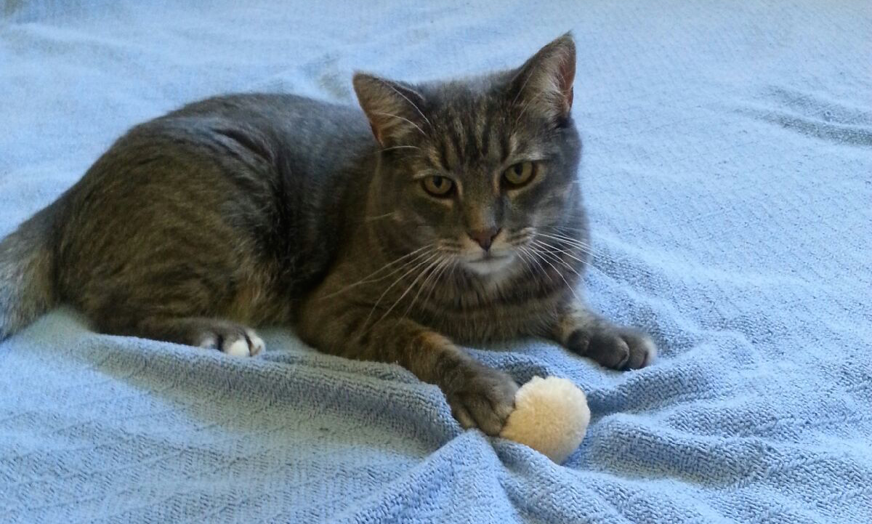
The Reason the Internet was Created

Slide 3
Differences
Camera vs. screen vs. print
Amount of detail varies
Small files → fewer details
But faster downloading

Slide 4
Analog
Paintings
Film
Continuous colors and shades
No hard edges

Slide 5
Digital
Raster – a line of dots
Black and white
Color
Dots are called pixels
Picture elements
Overall called raster graphics
Vs. vector graphics

Slide 6
Human Vision
The central retina is cone-dominated and the peripheral retina is rod-dominated
In total there are about seven million cones and a hundred million rods
Three kinds of cones
Cones approximately for color and rods for B&W
Analog or digital?
Notes:
https://en.wikipedia.org/wiki/Retina

Slide 7
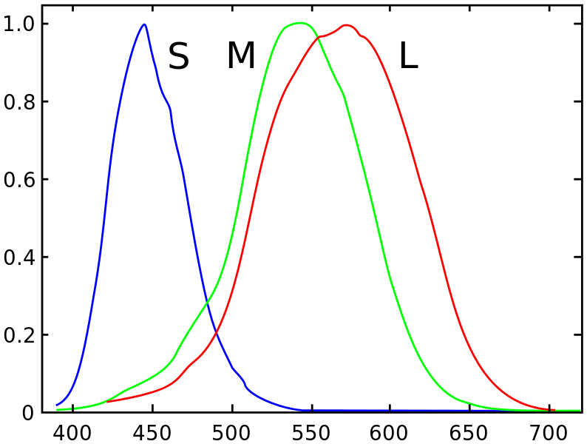
Cone Responses

Slide 8
Screen
Typically ~72 dots per inch (DPI)
Printer 300 – 1200 DPI
DPI called resolution
Original: 1235 × 743 pixels, 1.7 MB
618 × 372 pixels, 415 KB
309 × 186 pixels, 123 KB
155 × 93 pixels, 35 KB
78 × 47 pixels, 11 KB

Slide 9
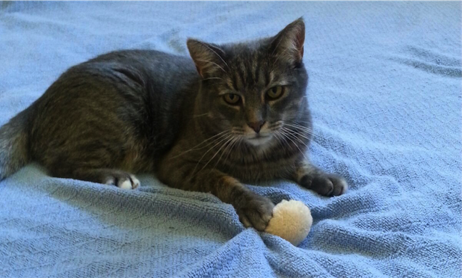
Half

Slide 10

Quarter

Slide 11

Eight

Slide 12

Sixteenth

Slide 13
Storage
Values typically stored in bytes
One byte can represent gray scale
With 256 values between black and white
Called gray (or grey) scale
Three bytes typically used to store color
Red, Green, Blue
Cyan, Yellow, Magenta

Slide 14
Bitmap
Contains all information with no compression
Suffix: .bmp
Typically larger than other formats

Slide 15
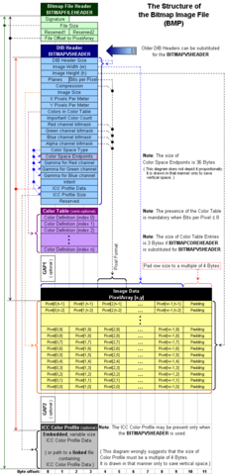
BMP File Format

Slide 16
Additive and Subtractive Colors
Projection vs. reflection
Monitors add RGB together
Each “dot” actually three dots
Each “dot” can take 256 values
Color ranges called “gamut”

Slide 17
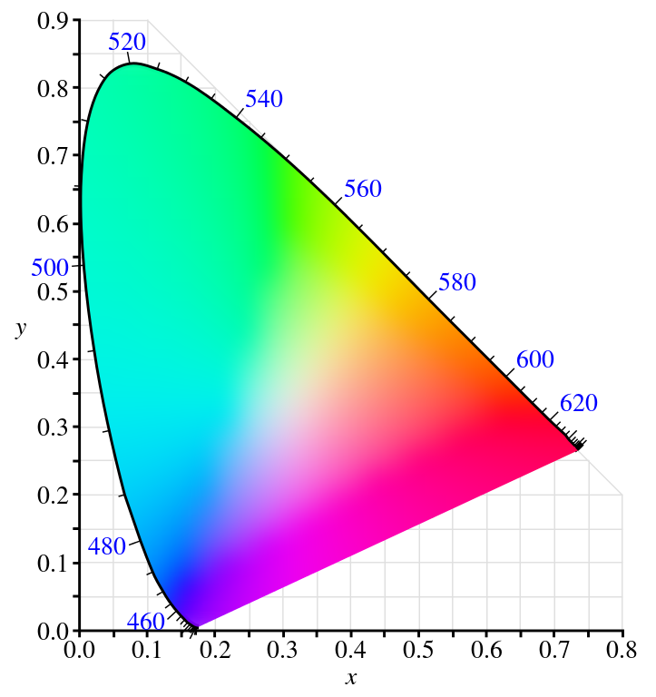
Full Gamut

Slide 18
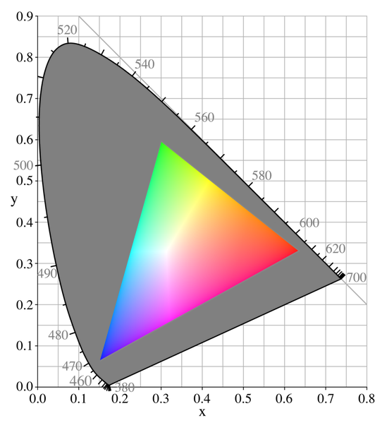
Monitor Gamut

Slide 19
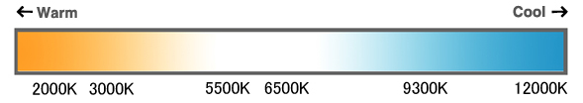
Color Temperature
Notes:
http://www.eizo.com/library/basics/color_temperature_on_an_LCD_monitor/

Slide 20
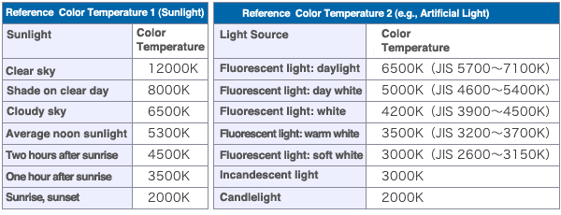
Color Temperature

Slide 21
Color Printers
Reflect light
Colors absorb other colors
Cyan contains blue and green
Removing red
Yellow contains red and green
Removing blue
C+Y mixed removes red and blue
Leaving green

Slide 22
Color Printers
Typically also have a black cartridge
CMYK
‘K’ for blacK as B was already taken for blue in RGB

Slide 23
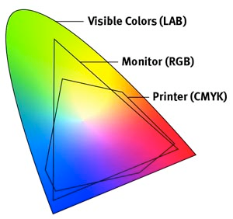
Printer Gamut
Notes:
http://www.okidata.com/printer-color-matching-made-easy?print=1

Slide 24
Compression
Sometimes, we’d like smaller files, but we have to do more calculations
Time/space tradeoff
Data compression
Lossless – data are compressed, but no information is lost
Lossy – some information is lost, but hopefully not important

Slide 25
Color Tables
If image doesn’t use all the possible colors, add a table of those it does contain
Each pixel then refers to location in color table
E.g.: if there are 256 or fewer colors, each pixel can be one byte instead of three
Called Look Up Table (LUT)
Usually better for discrete colors
Lossless if enough colors in color table

Slide 26
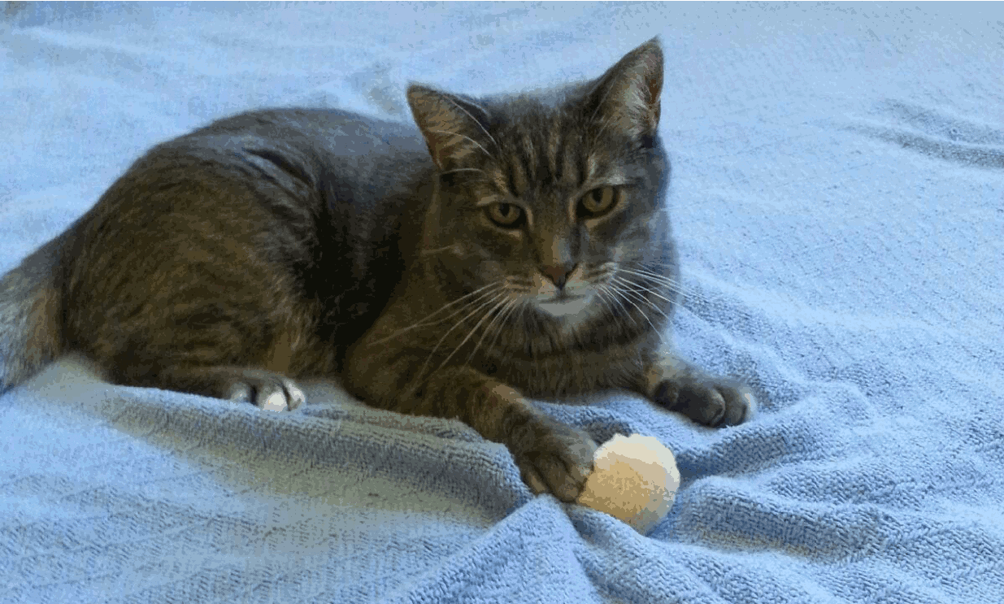
100 Colors

Slide 27
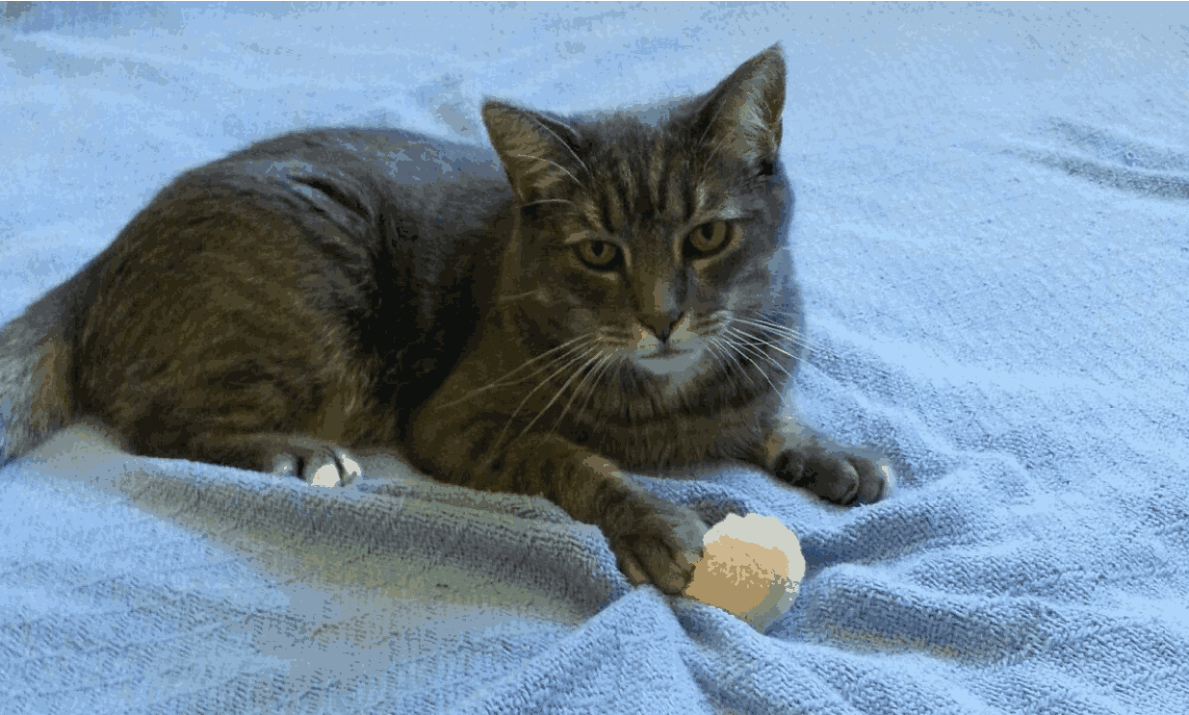
50 Colors

Slide 28
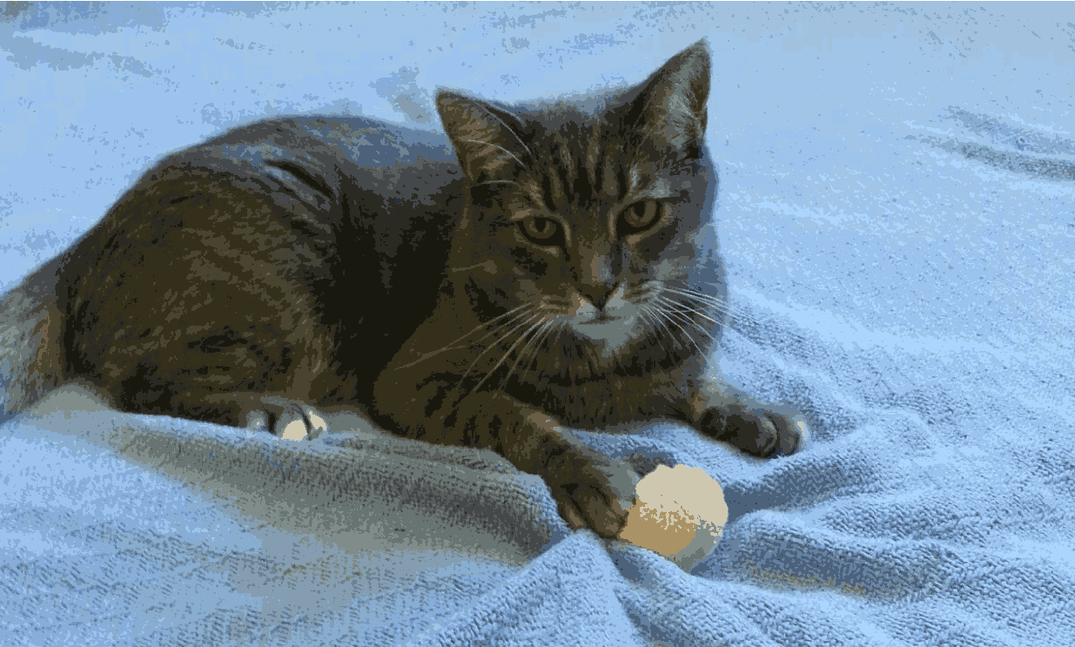
25 Colors

Slide 29
Other Tables
Font tables similar to color tables
Typical fonts stored in OS, browser, printer
Atypical fonts downloaded
Same for shape tables

Slide 30
Vector Graphics
Store basic shapes instead of bitmap
“Infinitely” scalable
SVG – scalable vector graphics
Built in to HTML5
Description in XML

Slide 31
SVG Example
<svg xmlns="http://www.w3.org/2000/svg" version="1.1">
<rect x="25" y="25" width="200" height="200" fill="lime" stroke-width="4" stroke="pink" />
<circle cx="125" cy="125" r="75" fill="orange" />
<polyline points="50,150 50,200 200,200 200,100" stroke="red" stroke-width="4" fill="none" />
<line x1="50" y1="50" x2="200" y2="200" stroke="blue" stroke-width="4" />
</svg>
Notes:
https://en.wikipedia.org/wiki/Scalable_Vector_Graphics

Slide 32
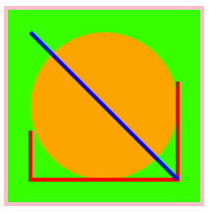
SVG Example Drawn

Slide 33
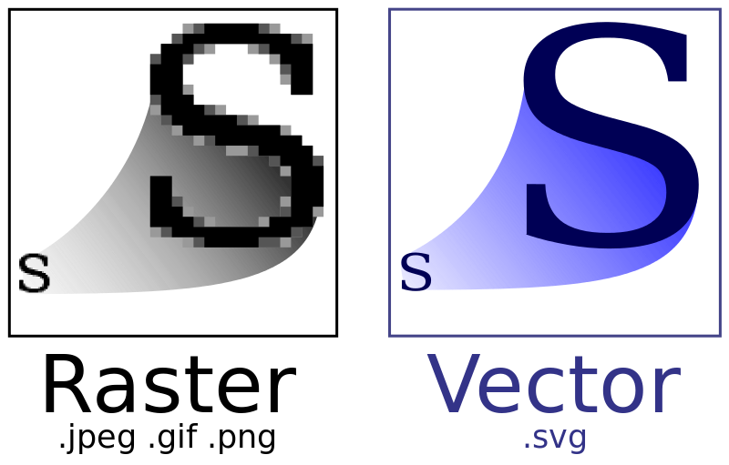
Scalable
Notes:
https://en.wikipedia.org/wiki/Scalable_Vector_Graphics

Slide 34
Encoding
Choose the shortest codes for the most popular symbols
Morse code
Huffman encoding
FAX
Mostly white, so white == 1
00 for black and 01 for gray

Slide 35
Encoding
We can tell what each color is
If bit == 1, white
If bit == 0
If next bit == 0, black
If next bit == 1, gray

Slide 36
Run-Length
Instead of storing all copies of identical bits, store count
Instead of storing fifty ‘1’s
Say “there are fifty ‘1’s”
Much shorter

Slide 37
File Types
GIF: one or more color tables
PNG: similar to GIF, but not patented
Also more flexible
PS: PostScript
Both vector and raster
PDF: Portable Document Format
Extension/modification to PostScript

Slide 38
Sample and Average
Choosing what data to store: sampling
Reconstructing from sampled data: averaging
Lossy

Slide 39
File Types
JPG or JPEG: Joint Photographic Experts Group
Based on human sight
More sensitive to brightness than color
Uses discrete cosine transform
Remove sharp transitions of brightness and color
Image broken into 8x8 squares and sampled
Notes:
https://en.wikipedia.org/wiki/JPEG

Slide 40
Quality
90: 234 KB
50: 90 KB
10: 28 KB

Slide 41

90

Slide 42

50

Slide 43
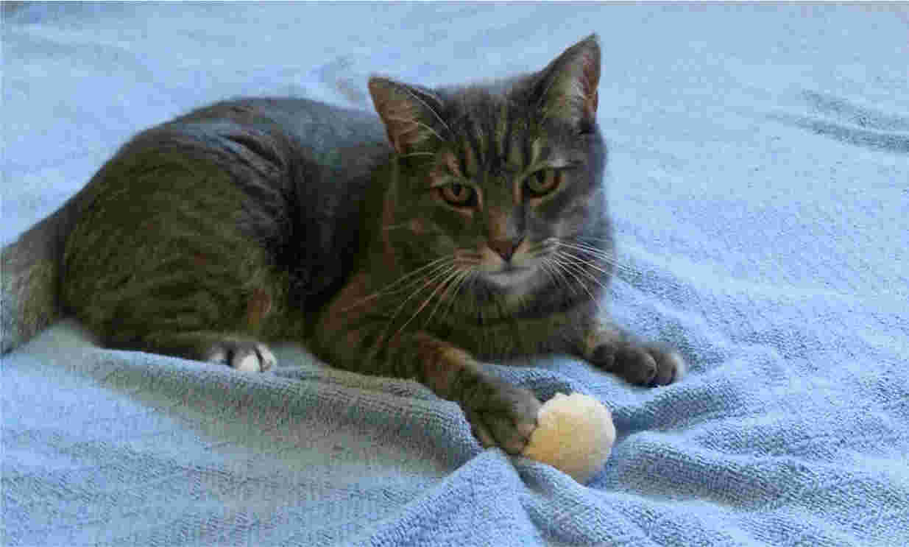
10

Slide 44
Format Matters
Use lossless until the final save
Edit in tiff, gif, png, etc.
Each lossy save loses information (resolution)

Slide 45
MP3
Lossy audio compression
Specify data rate
128 Kbps 1/11 size of CD quality
Based on psychoacoustics
Not all sounds equally important
Not all people equally sensitive
E.g.: one tone less audible if lower tone present
Notes:
https://en.wikipedia.org/wiki/MP3

Slide 46
Development
The song "Tom's Diner" by Suzanne Vega was the first song used by Karlheinz Brandenburg to develop the MP3. Brandenburg adopted the song for testing purposes, listening to it again and again each time refining the scheme, making sure it did not adversely affect the subtlety of Vega's voice.

Slide 47
Bit and Sampling Rates
Constant Bit Rate and Variable Bit Rate
32, 40, 48, 56, 64, 80, 96, 112, 128, 160, 192, 224, 256 and 320 Kbps
Sampling frequencies of 32, 44.1 and 48 kHz

Slide 48
MPEG
Motion Picture Experts Group
MPEG-1: Video CD
MPEG-2: HDTV, cable, DVD, etc.
MPEG-4: shapes and textures
Video has both spatial and temporal locality
Parts of the scene remain relatively stable
Scenes remain relatively stable over time

Slide 49
Review
Questions: 1, 2, 5, 8, 9
Exercises: 2
Research: 1

